Slide 1
Taking measurements from single-side HPF to measure Vphase and Vneutral
14th October, 2014
Manoj Gulati

Slide 2
Task planned in last meeting (07-10-2014)
Check if termination impedance of equipment is 50 ohm than if it has to be included in computing High pass filter cut-off.
Make two such circuits on a good quality PCB board.
Test this circuit with DMM and DSO to measure input & output voltages and cal. attenuation offered.
Test Mixed Domain Oscilloscope 4104-06 (to be used for time domain measurements)[configuration, probe calibration, data dump].
Try to dump data from two channels simultaneously (at same start time).
Get Vphase and Vneutral data with a single appliance from MDO.
Compute Vcm and Vdm using Vphase and Vneutral data in MATLAB and compute FFT for this.
Match Vdm results with previous results from EMI paper.

Slide 3
Check if 50 ohm termination of equipment has to be considered while calculating cutoff of filter.
Answer is yes if it is a 50 ohm termination the resultant will turn out to be 25 ohm. But following RF circuit principles this is meant to provide a matched termination so that no reflections occur at the end of transmission line.
After a brief discussion with Tektronix people, this is a bit of subjective question as it depends on probes and termination selection of equipment. Most of the probes/equipment are meant for one of the two terminations (1Mohm or 50 ohm) and probes have internal feedback based compensation system to match with these terminations.
NB: We have only 1Mohm based compensated probes. Normal BNC cables can be used for 50 ohm termination but they have to be matched using function generators. Tektronix people will come in day or two to demonstrate this as my trials were not successful.

Slide 4
Testing of single sided HPF without any load
Mains
Power Supply
Phase
Earth
Neutral
0.1uF
Node A
R
Node B
Vrms = 230V
50 Hz
Vp = 326V
C
100
70
R
70
Vphase
R
0.1uF
Node A
Node B
R
Vrms = 230V
50 Hz
Vp = 326V
C
100
70
R
70
R
Vneutral

Slide 5
Calculations/Testing HPF (Mains power supply)
Input Voltage Vrms = 228V (50 Hz Mains) [measured with multimeter]
Input Voltage Vpeak = 322.4V
Output Voltage Vrms = 123.76mV (50 Hz)[measured with DSO]
Output Voltage Vpeak = 175mV (50 Hz)
Calculations:
Attenuation (offered at 50 Hz) = -65.30 dBV
Power observed(across 50 ohm load) = -32.12 dB
= -2.12 dBm

Slide 6
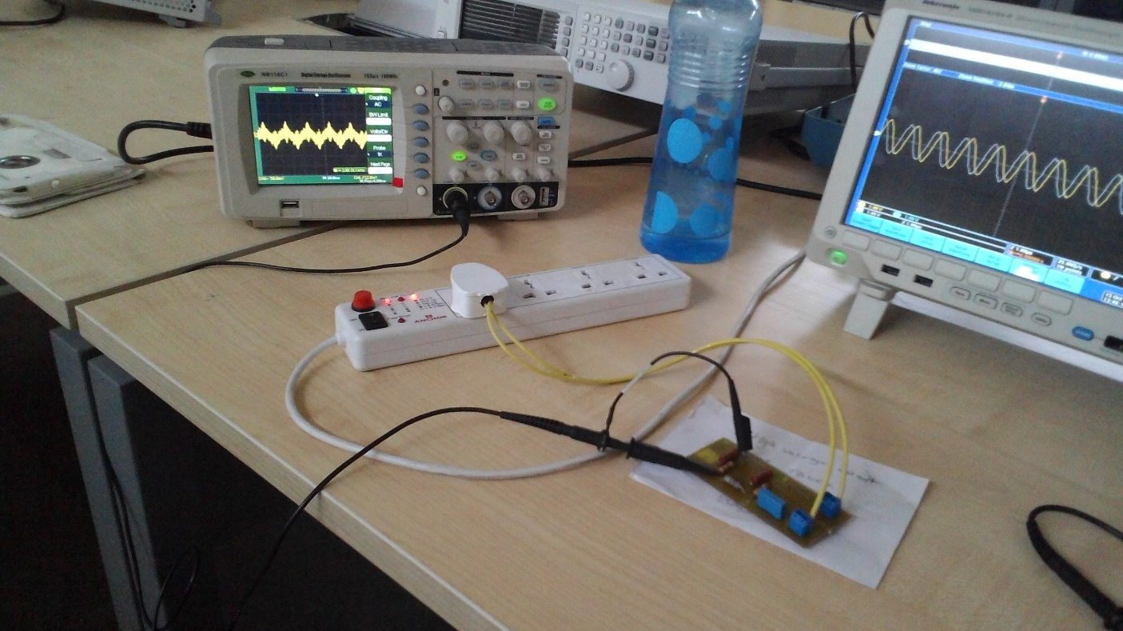
Setup with DSO

Slide 7
Configuration of Mixed Domain Oscilloscope
Configuration
Sampling frequency Fs = 25Msa/s [Best 5 Gsa/s]
No. of points in time domain = 1M [Max. 20M]
Task-1 Calibrate 1Mohm probes and take one trace from function generator. [Done]
Task-2 Capture traces simultaneously from two channels using 1Mohm probes (used two function generator). [Done, results on next page]
Sine Wave
2Vpp 1MHz
Function Generator-1
Mixed Domain Oscilloscope
Capture Time = 0.04 sec
No. of points in time domain = 1M
Sampling Freq. Fs = 25Msa/s
CH-1
CH-2
Cosine Wave
2Vpp 1MHz
Function Generator-2

Slide 8
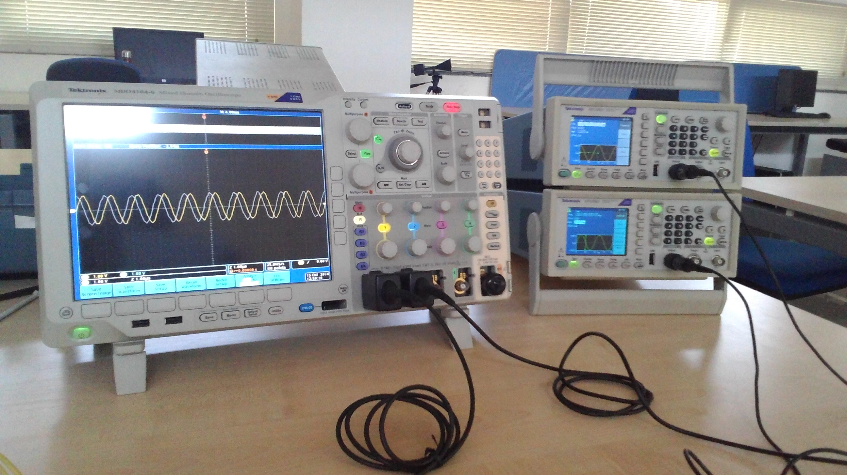
Snapshot of setup

Slide 9
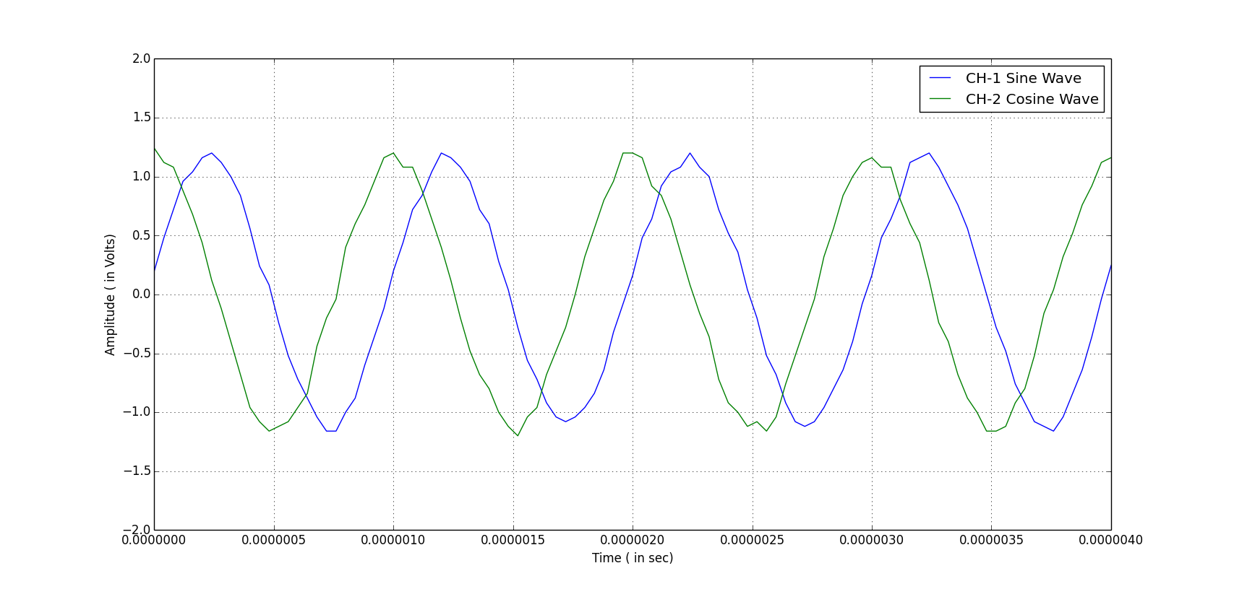
Capturing two simultaneous channels on Oscilloscope

Slide 10
Tasks pending for next week
Get Vphase and Vneutral data with a single appliance from MDO.
Compute Vcm and Vdm using Vphase and Vneutral data in MATLAB and compute FFT for this.
Match Vdm results with previous results from EMI paper.

